Slide 1

The Salah Of Rasulullah (SAW)
“Perform Salah as you see me perform Salah”

Slide 2
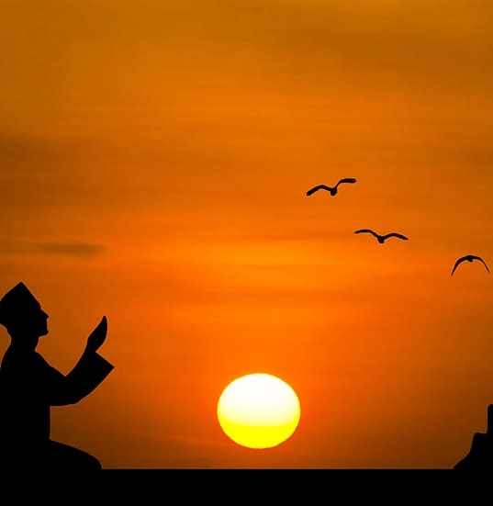
Hadith
The first matter that the slave will be brought to account for on the day of judgement is Salah. If it is sound, then the rest of his deeds will be sound. But if it is corrupt, the rest of his deeds will be corrupt.” Tabrani

Slide 3
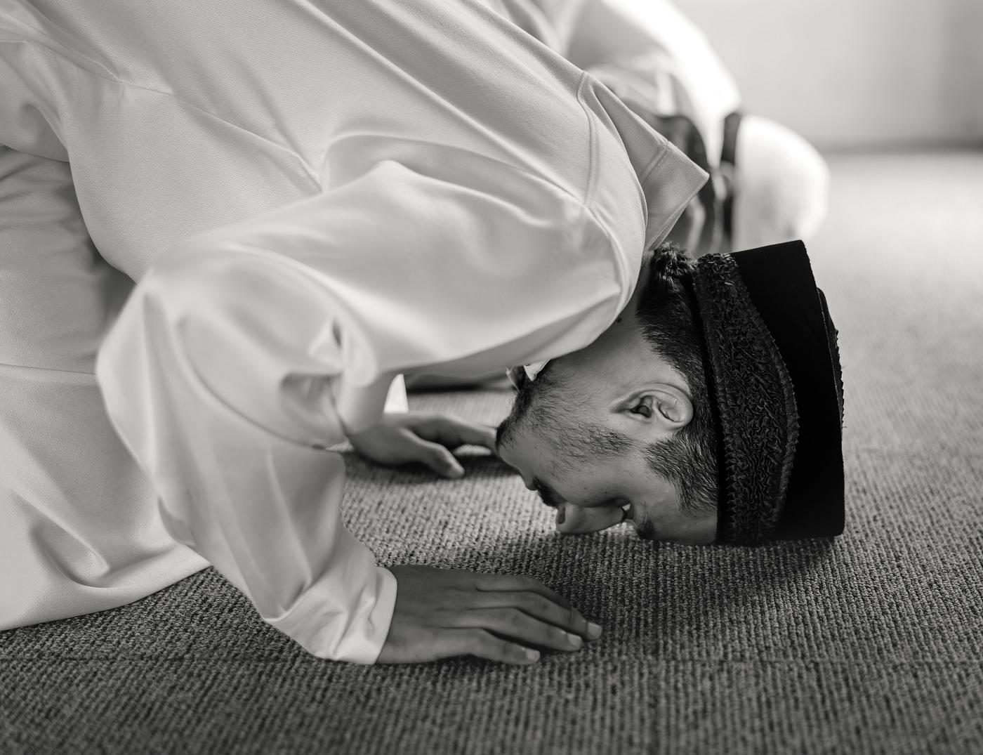
Quran
“Indeed, mankind was created anxious: when evil touches him, impatient, and when good touches him, withholding (of it), except the observers of prayers – Those who are constant in their prayer.” (Quran 70:10 – 23)

Slide 4

Virtue
The Prophet (SAW) said: “If there was a river at one’s door in which he bathed five times a day, what do you say: will any dirt remain on him?” They said, “No dirt will remain on him.” He replied, “That is the example of the Five Salahs; Allah removes sins through them.” Bukhari, Muslim

Slide 5
The Chapter Of Prayer – Conditions of prayer
3 conditions of prayer:
Islam – must be a Muslim to pray
Buloogh – maturity, a person must be of age to pray
‘Aql - Sanity
“One is to order his children to pray at the age of seven, and discipline them to pray at the age of ten for neglecting prayer…”
Discipline – not to injure them, or to inflict physical pain, rather use sensible and reasonable discipline

Slide 6
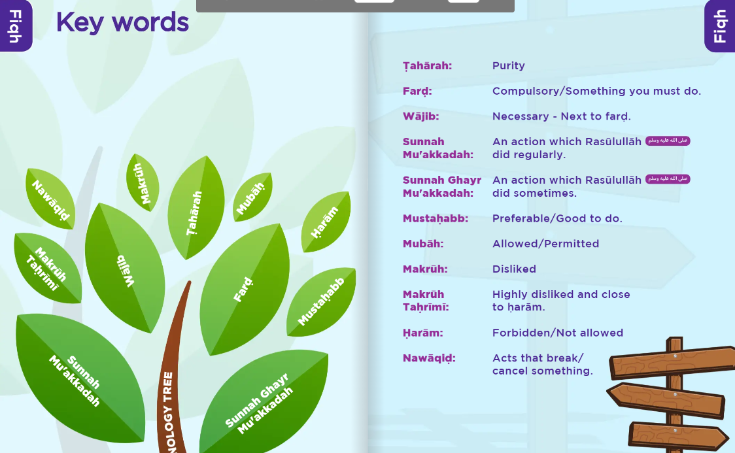

Slide 7
7 Conditions OUTSIDE of Salah
Place
Clean
Body
Wudhu/Ghusl
Clothes
Clean
Satr
Covered
Time
Correct
Direction
Qiblah
Intention
Which Salah?

Slide 8
6 Pillars/Fard IN Salah
Takbir Tahreemah
1st Takbeer
Standing
Reciting
Quran
Ruku
Sujood
The last Sitting
Tashahud

Slide 9
Detailed explanation on Fard of Salah
Place: Praying On the Ground
The basis of prostration is to place the forehead on the ground. Something is placed on the ground is not seen and an obstructive barrier since one can feel the hardness of the ground through it. [Ibn ‘Abidin, Radd al-Muhtar]. If the barrier was such that if one, hypothetically speaking, were to push down, one could not feel the hardness of the ground, such a barrier would not be valid to pray on. [Ibid.]
Satr/Awrah:
Covering one’s nakedness (awra) is a condition for the validity of one’s prayer. The awra of a man is from his navel to his knees. The awra of a woman is all of her body excluding her face, hands and feet (though it is superior for her to cover her feet as well, as many scholars considered the feet to be part of her awra). If some part of one’s nakedness shows during the prayer, then it is excused so long as the exposed area is less than a quarter of a limb’. A limb’ is an independent body part. Ibn Abidin mentions that the awra of the male is broken down into eight limbs.

Slide 10
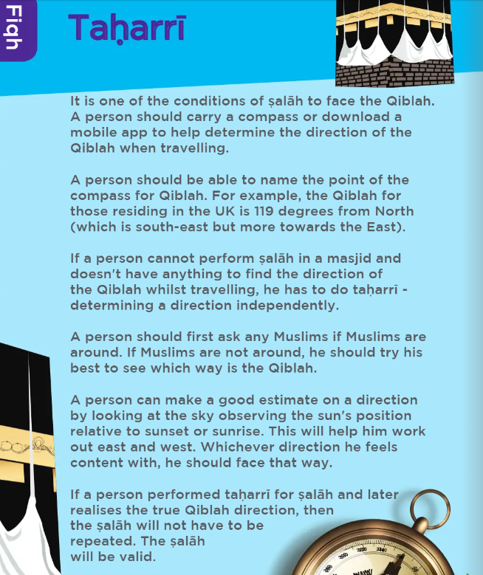
Detailed explanation on Fard of Salah
Facing Qibla:
The Ka'ba is our direction of prayer. If a person cannot for illness, fear or unable to dismount from a conveyance then the Qiblah is anyway that is safe for him.
A person has leeway of a total of 45 degrees from the qibla for it to be correct.
Facing the qibla means CHEST is to the Qibla
If a person who is able to perform Qiyām performs the Ṣalāh on the plane standing as he normally perform Ṣalāh, the Ṣalāḥ does not need to be repeated. Every effort should be made to perform Ṣalāh on the plane. If however, this is not possible, Ṣalāḥ should be performed on the seat and repeated on arrival.

Slide 11
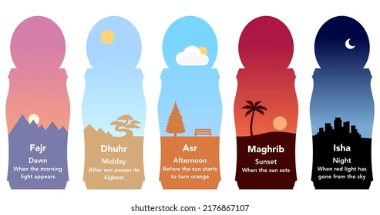
Timings of Salah

Slide 12
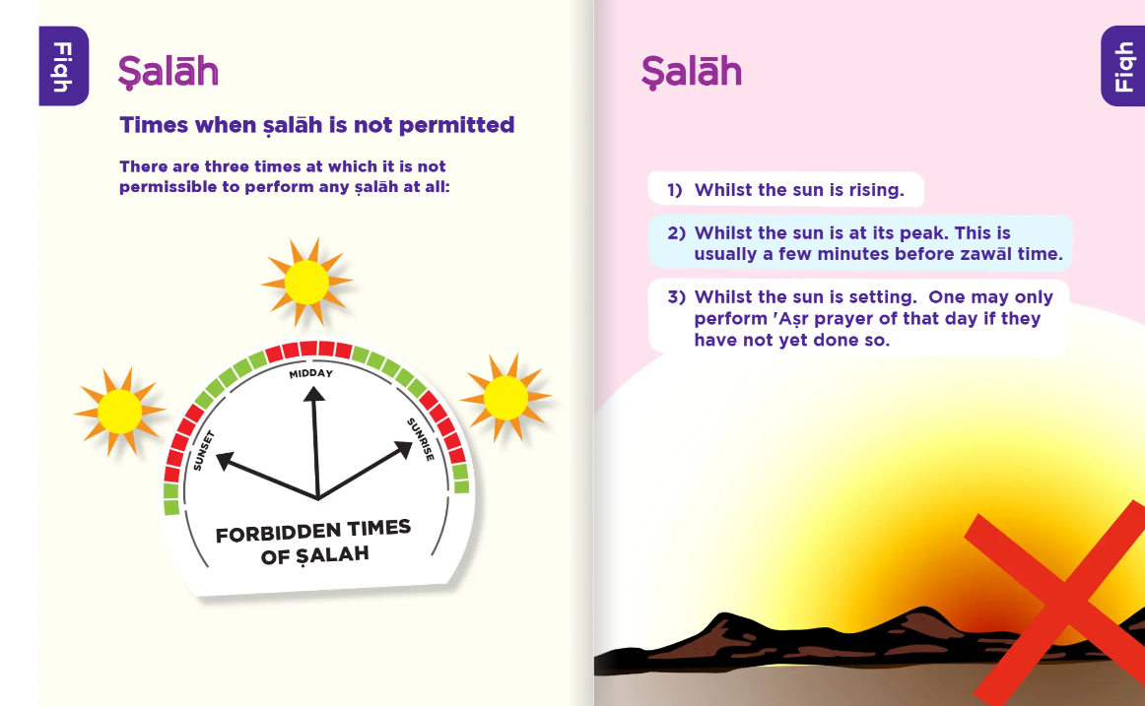
Makruh Timings of Salah
When one is hungry
When one needs to urinate etc
When there is very less time to complete fard salah and one starts voluntary salah
At the time of Iqamah
During the Khutbah
Before maghrib/after Asr

